Slide 1
Acoustic scattering by spheres and swim bladders

Slide 2
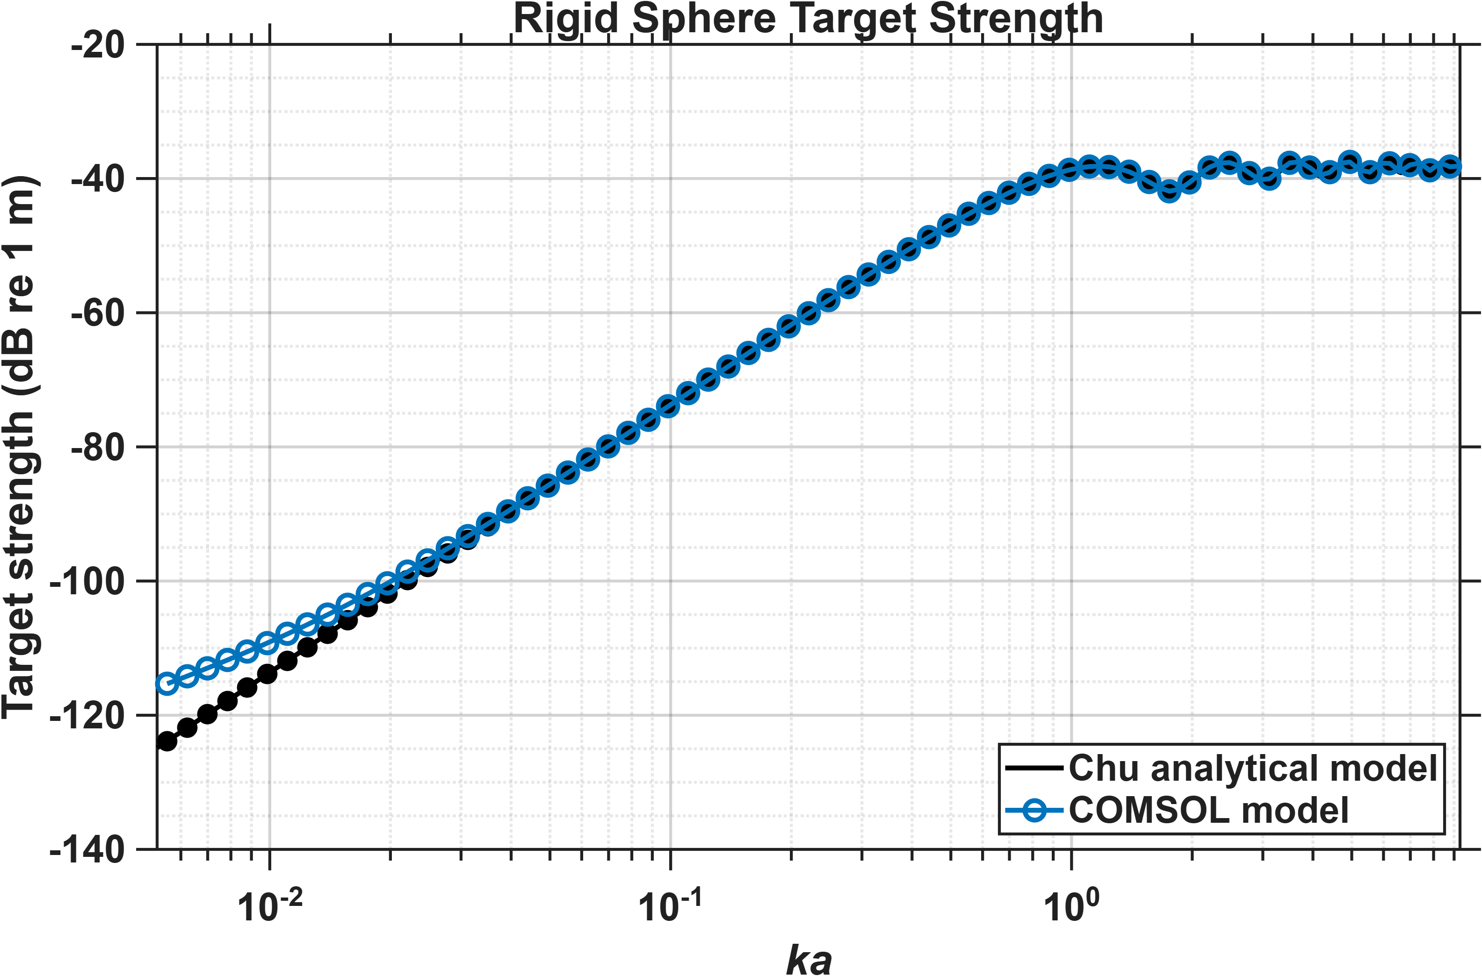

Slide 3
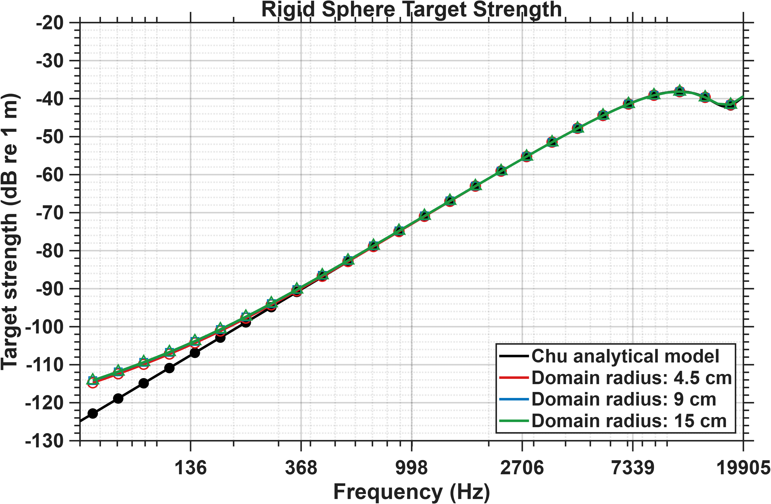
Mismatch does not reduce on increasing domain radius

Slide 4
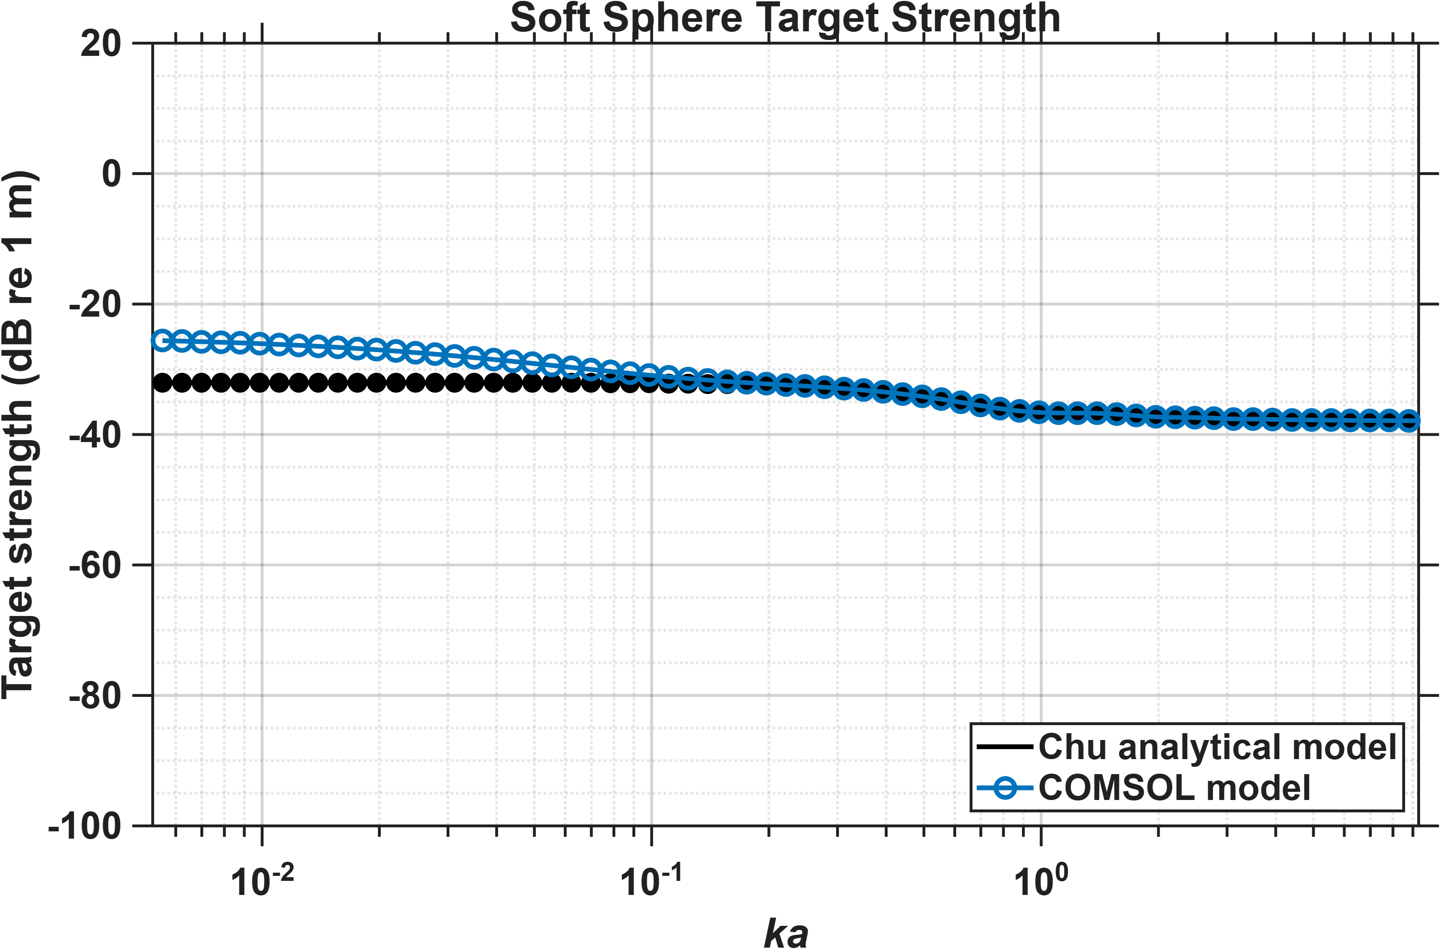

Slide 5
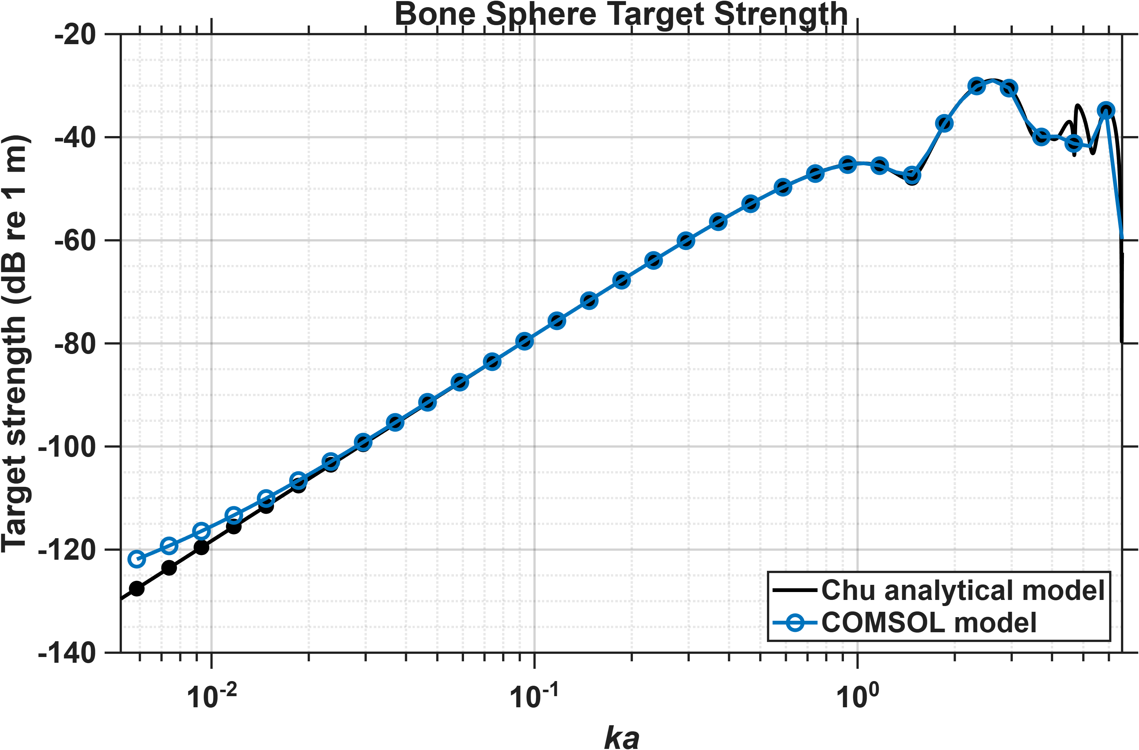

Slide 6
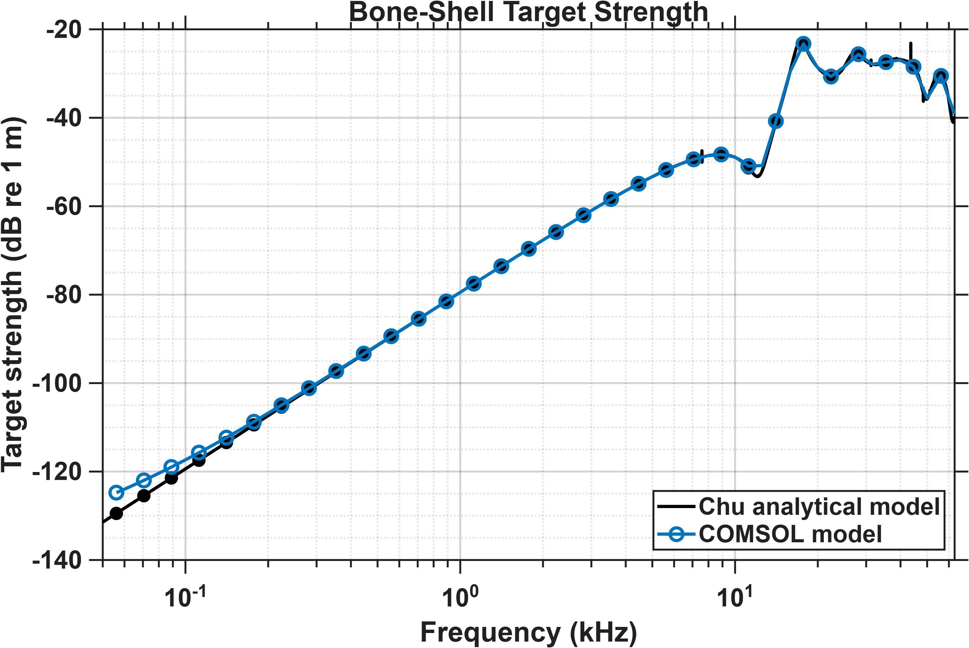
Radius of scatterer: 2.5 cm
Thickness of shell: 1 cm
Radius of domain: 4.5 cm
PML thickness: 1 cm
Physics-based mesh: Normal

Slide 7
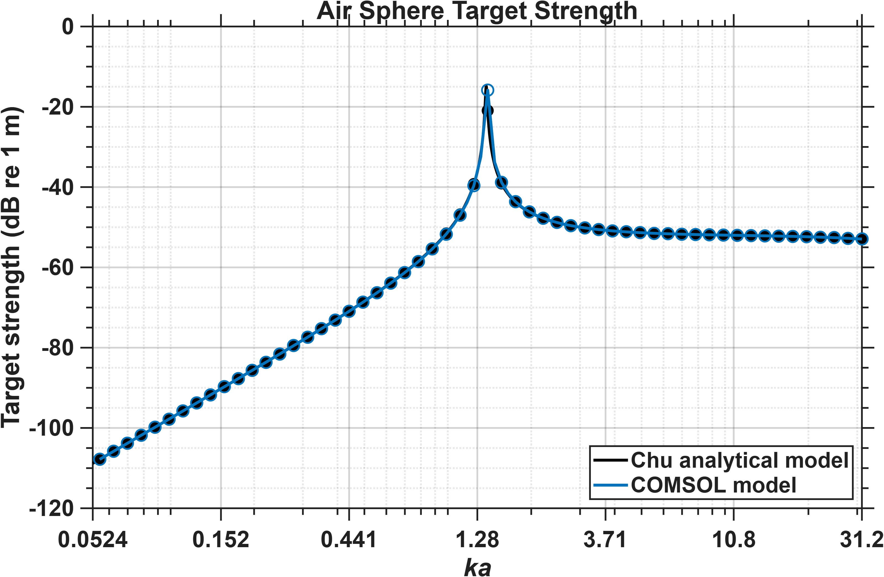
If I reduce my bubble size such that resonance is ka ~ 1 or greater, then there is a strong match between COMSOL and Chu
Radius of scatterer: 0.25 cm
Radius of domain: 4.5 cm
PML thickness: 1 cm
Physics-based mesh: Normal

Slide 8
Fish and swim bladder models

Slide 9
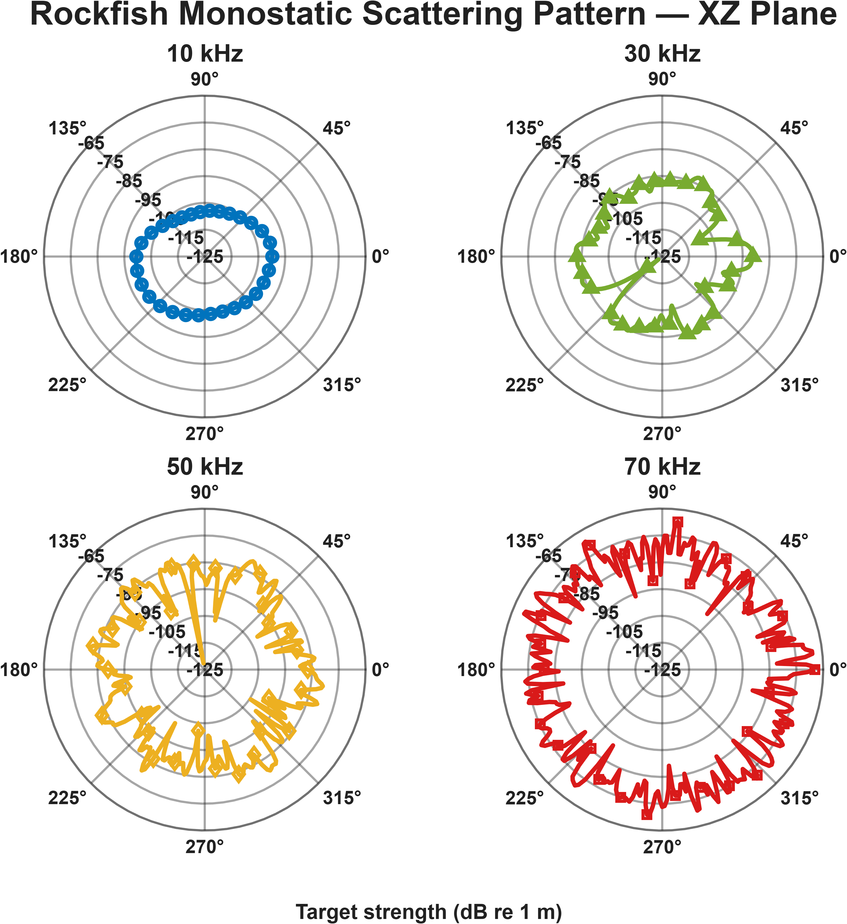
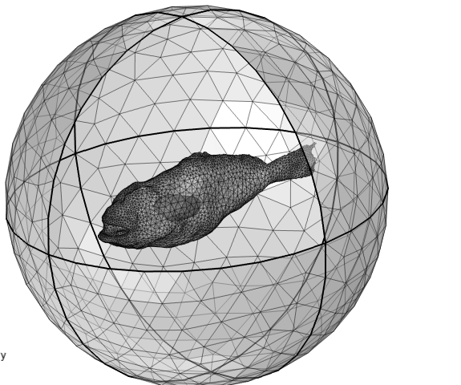
z
y
x

Slide 10
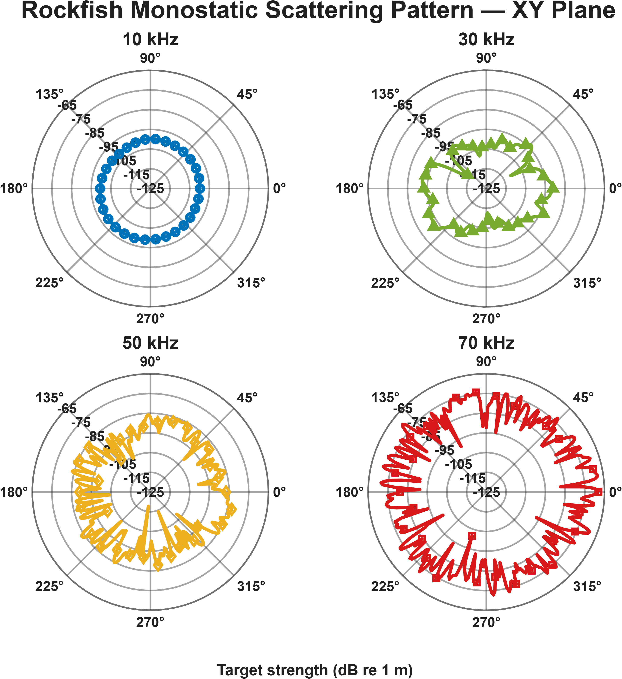
z
y
x

Slide 11
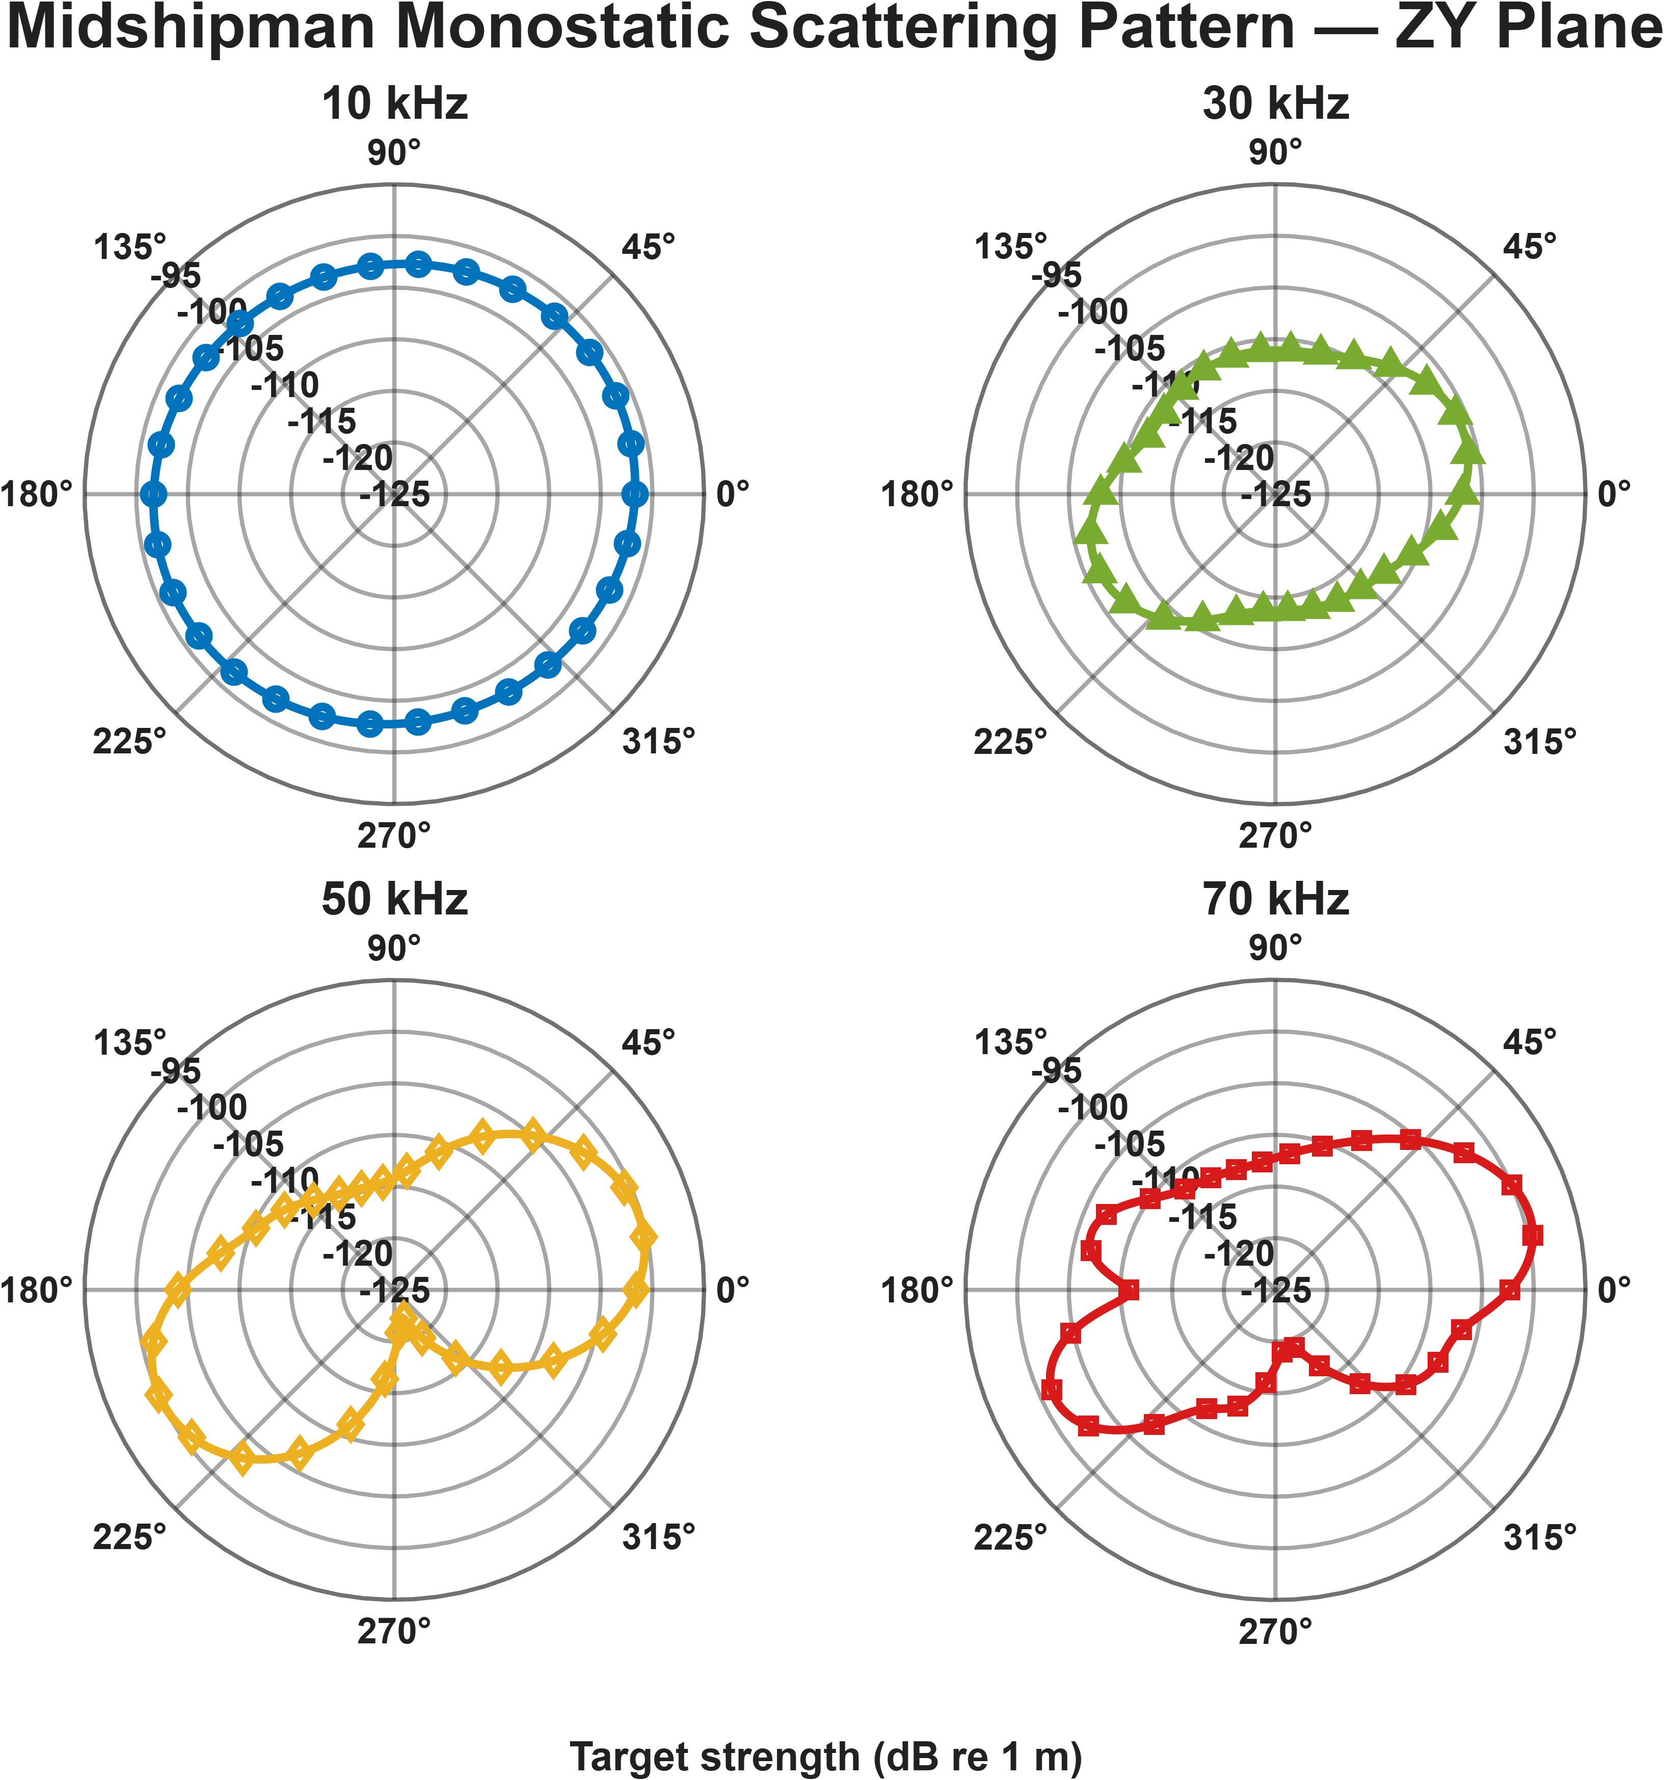
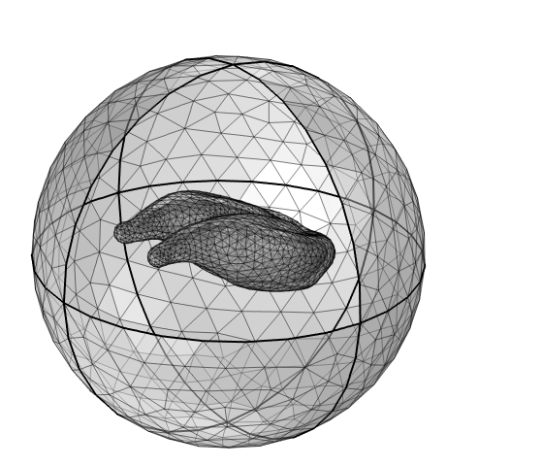
z
y
x

Slide 12
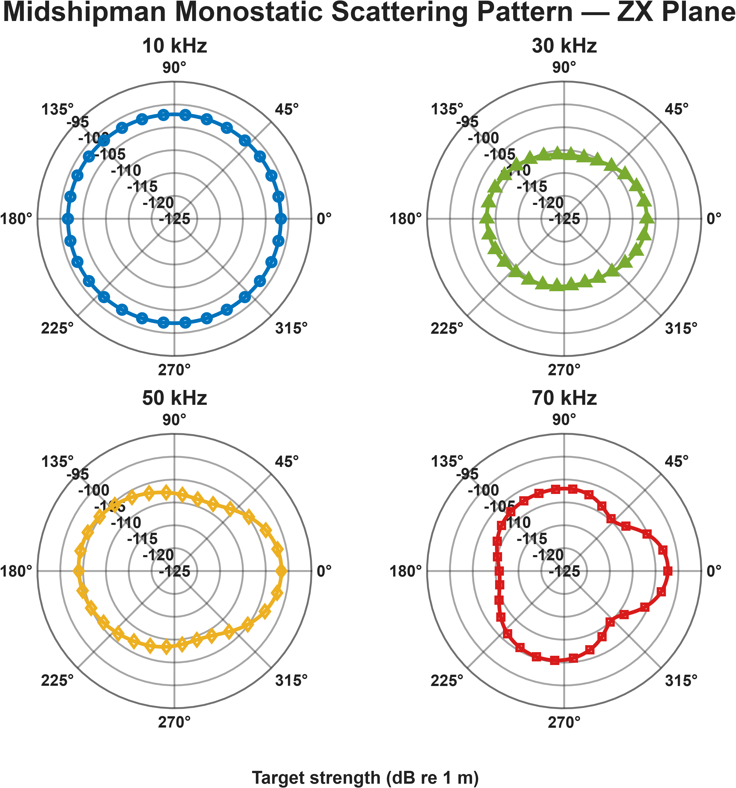
z
y
x

Slide 13
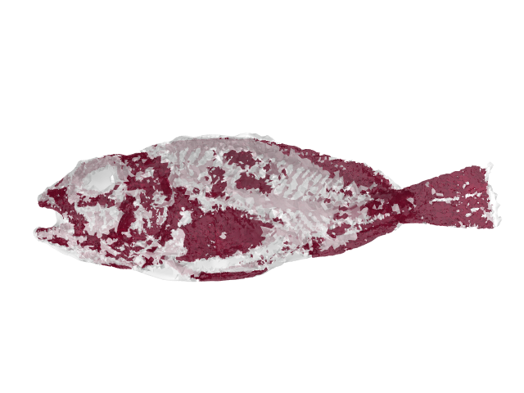
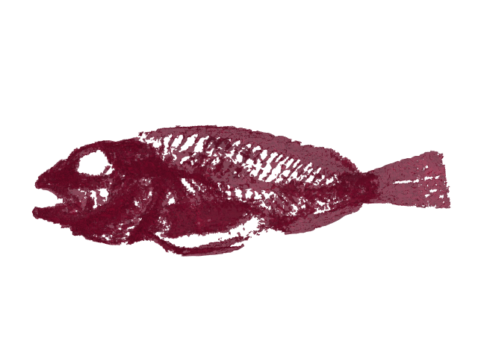
Voxel-based assignment of bone material
Volume plot of the binary bone mask in COMSOL (red voxels = bone; white voxels = tissue)
1. Export segmented coordinates from 3D Slicer with binary labels (1 = bone; 0 = tissue).
2. Retain only coordinates that fall within the processed fish-body surface mesh.
3. Import the data into COMSOL as a nearest-neighbor interpolation function
4. Use conditional expressions to assign bone or tissue material properties based on the interpolated label.

Slide 14
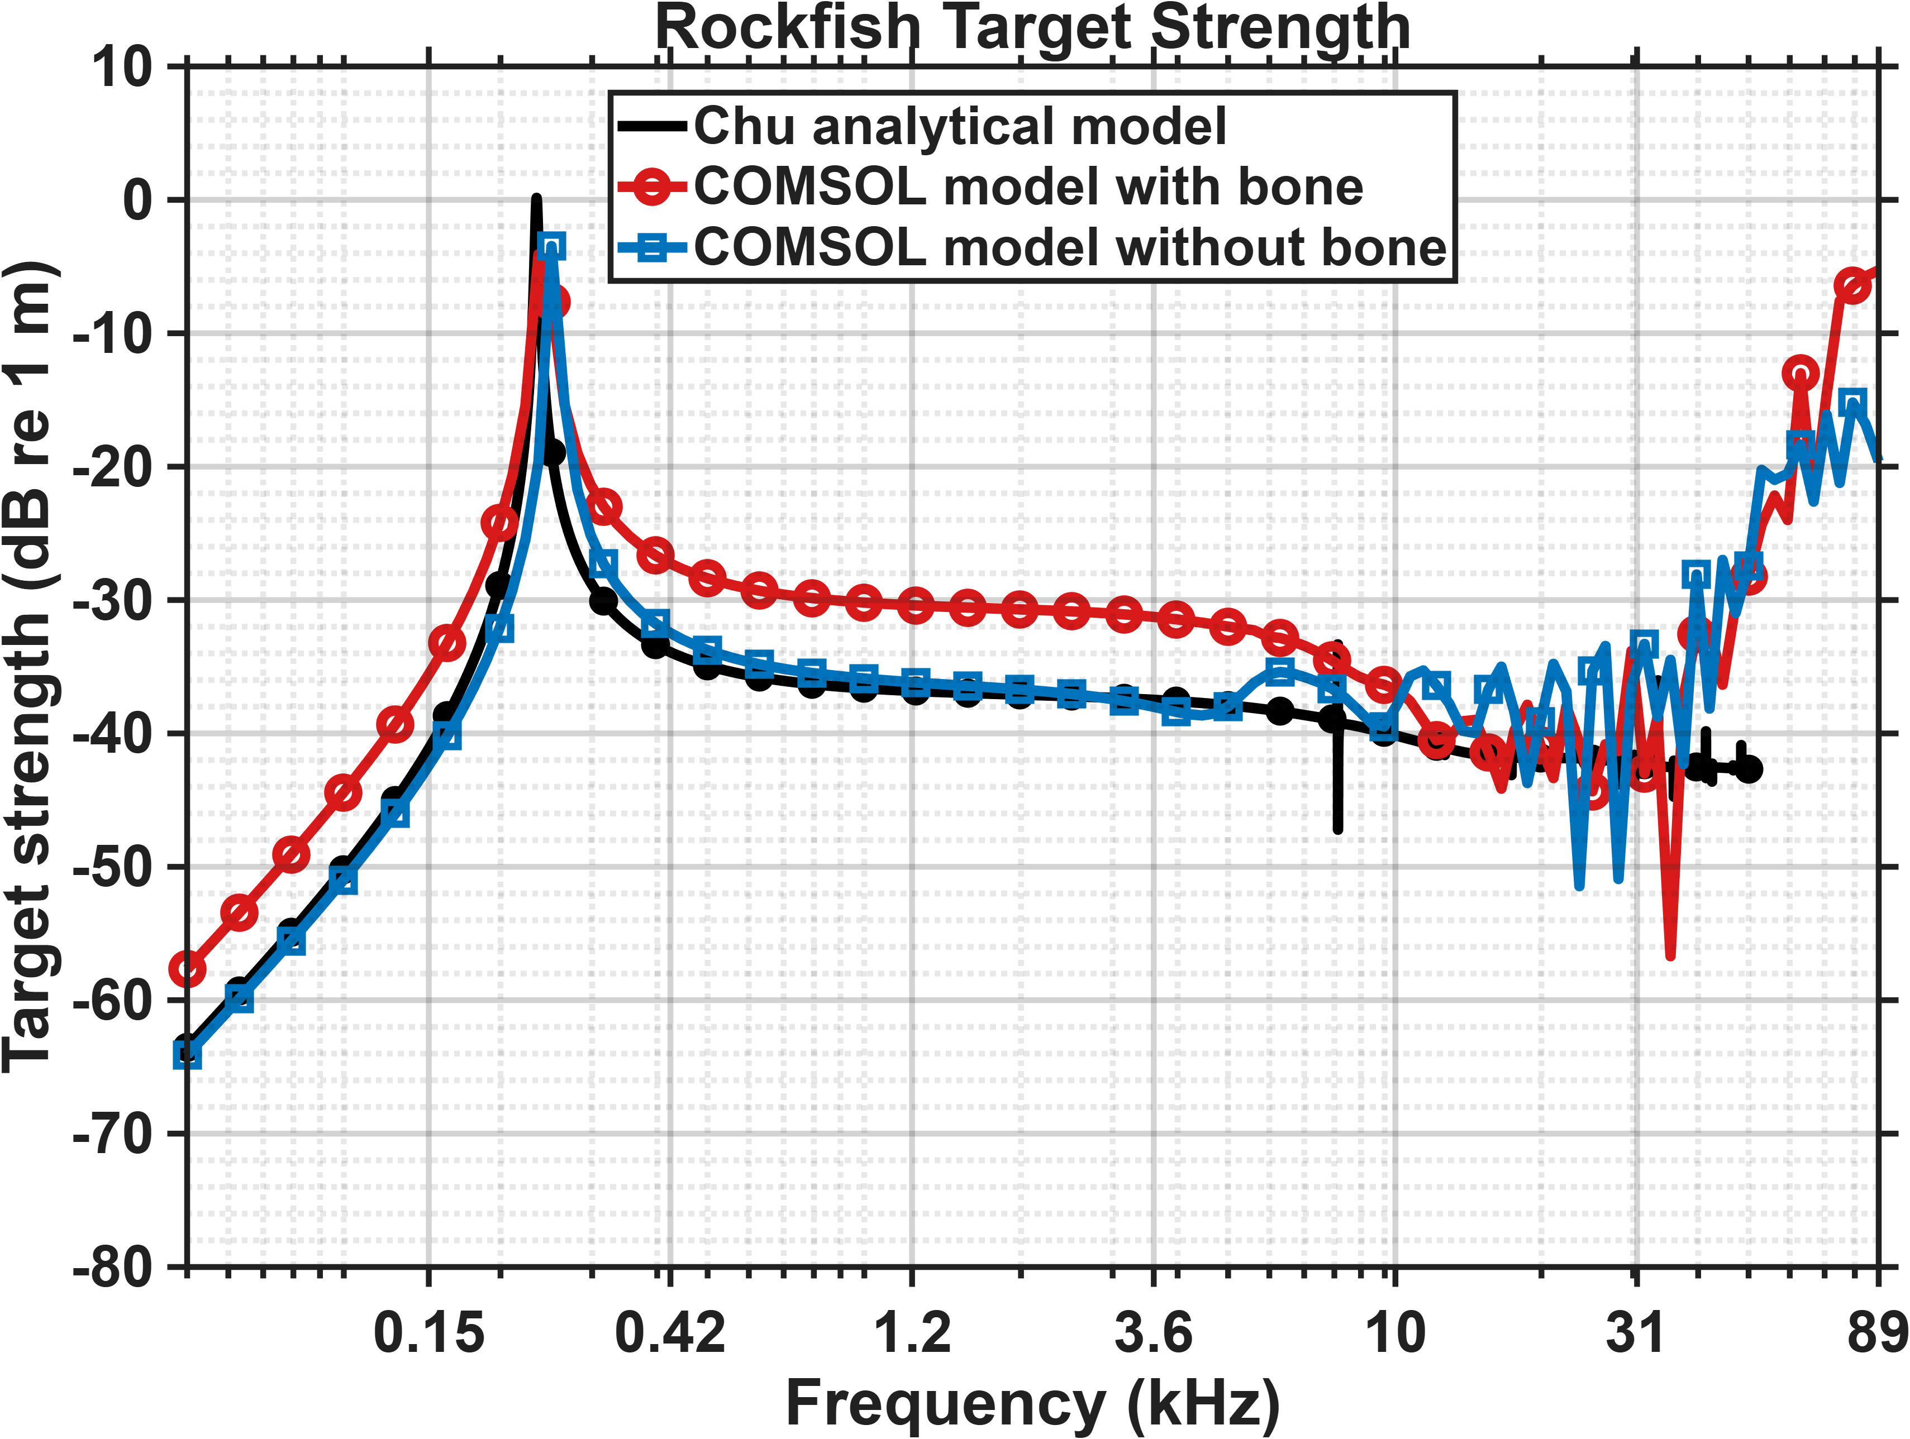

Slide 15
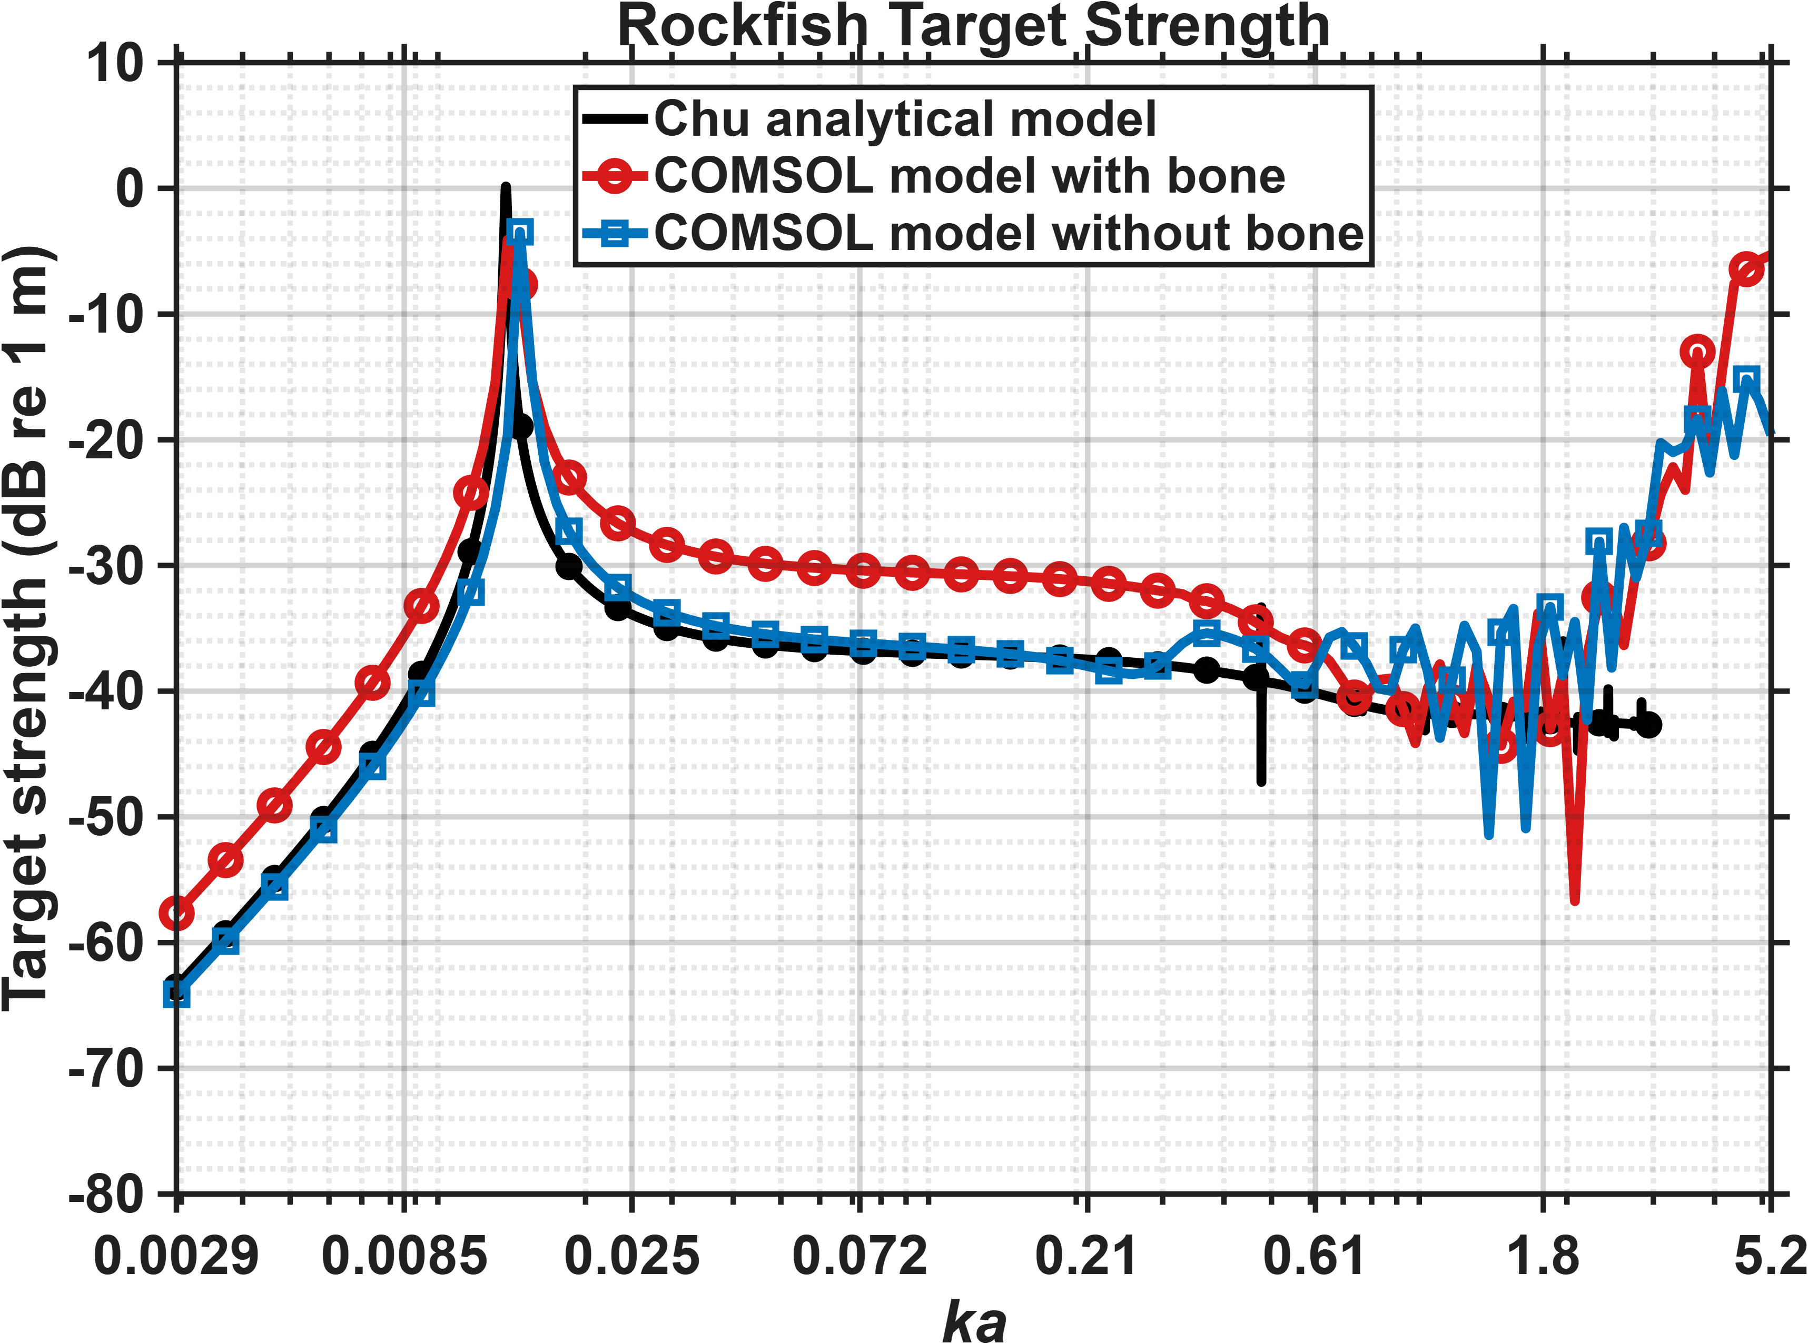

Slide 16
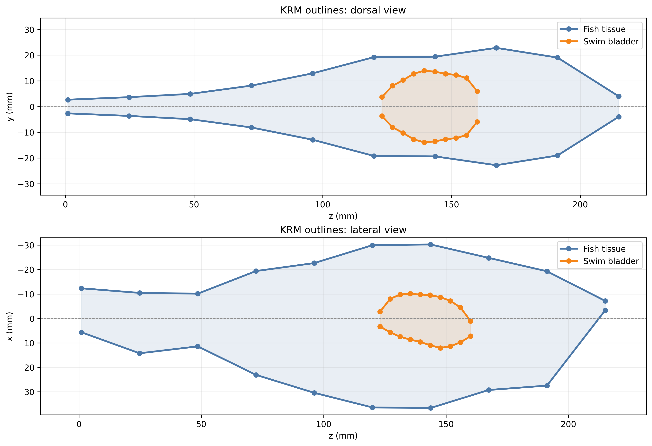
KRM still in progress. Here are outlines that I am using as input

Slide 17
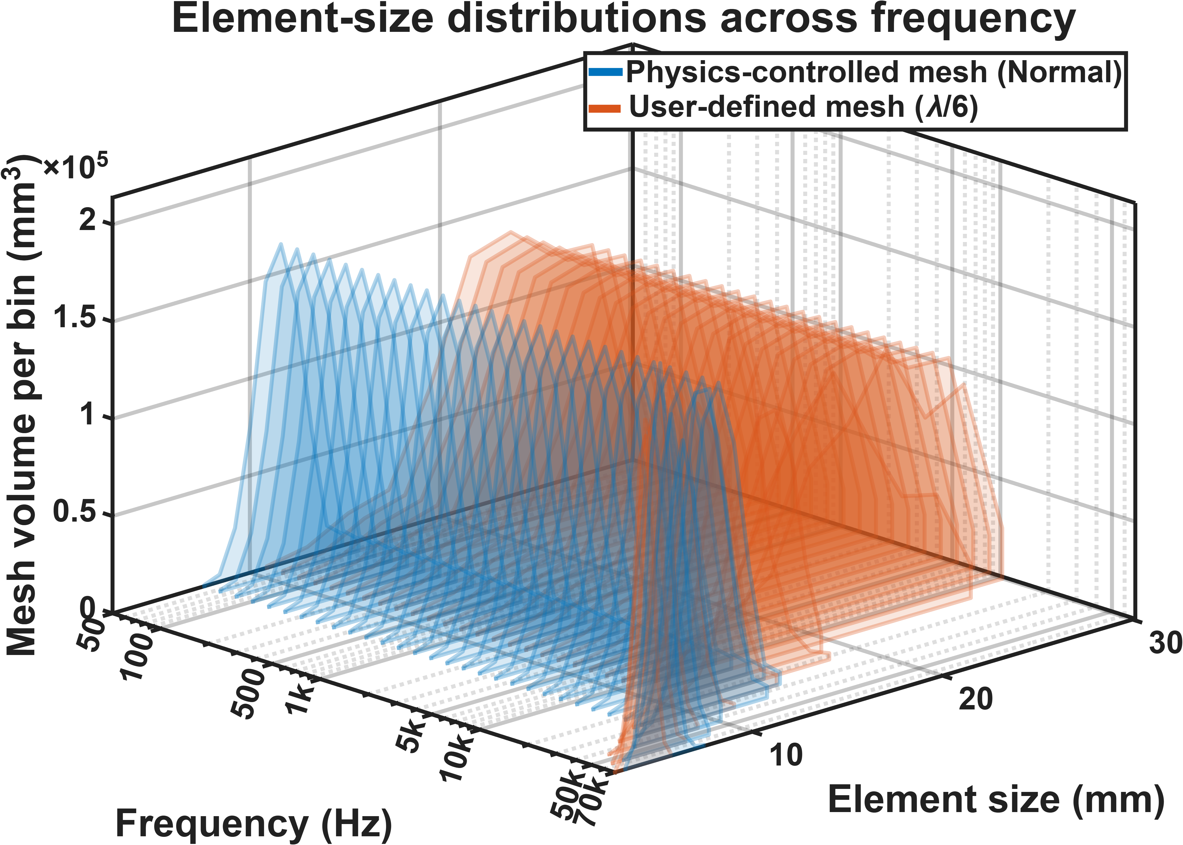
For soft sphere model

